Slide 1
IP Fragmentation
CS 6823 - Network Security
1

Slide 2
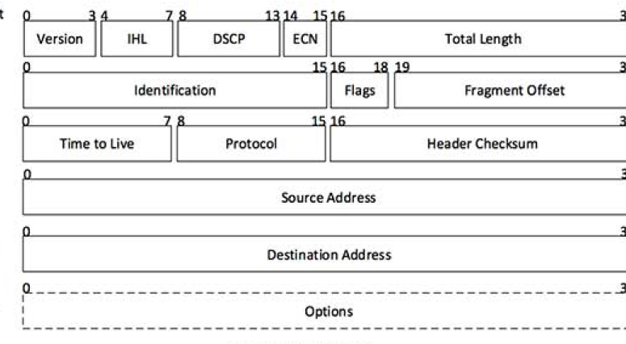
IP Header

Slide 3
IP Header
Version: Version no. of Internet Protocol used e. g. IPv4.
IHL: Internet Header Length; Length of entire IP header.
DSCP: Differentiated Services Code Point; this is Type of Service.
ECN: Explicit Congestion Notification; It carries information about the congestion seen in the route.
Total Length: Length of entire IP Packet including IPheader and IPPayload .
Identification: If IP packet is fragmented during the transmission, all the fragments contain same identification number to identify original IP packet they belong to.

Slide 4
IP Header
Flags: As required by the network resources, if IP Packet is too large to handle, these ‘flags’ tells if they can be fragmented or not. In this 3-bit flag, the MSB is always set to ‘0’.
Fragment Offset: This offset tells the exact position of the fragment in the original IP Packet
Time to Live: To avoid looping in the network, every packet is sent with some TTL value set, which tells the network how many routers hops this packet can cross. At each hop, its value is decremented by one and when the value reaches zero, the packet is discarded.
Protocol: Tells the Network layer at the destination host, to which Protocol this packet belongs to, i.e. the next level Protocol. For example protocol number of ICMP is 1, TCP is 6 and UDP is 17.

Slide 5
IP Header
Header Checksum: This field is used to keep checksum value of entire header which is then used to check if the packet is received error-free.
Source Address: 32-bit address of the Sender of the packet.
Destination Address: 32-bit address of the Receiver of the packet
Options: This is optional field, which is used if the value of IHL is greater than 5. These options may contain values for options such as Security, Record Route, Time Stamp, etc.

Slide 6
Interlude: IP datagram format
header length
(4-byte words)
32 bits
total datagram
length (bytes)
ver
head.
len
type of
service
4 (IPv4) – 0010
length
for
fragmentation/
reassembly
flgs
fragment
offset
16-bit identifier
“type” of data
time to
live
upper
layer
Internet
checksum
max number
remaining hops
(decremented at
each router)
32 bit source IP address
32 bit destination IP address
Options (if any)
upper layer protocol
to deliver payload to
data
(variable length,
typically a TCP
or UDP segment)
Notes:
Typical header size 20 bytes

Slide 7
IP Fragmentation and Reassembly
length
=4000
ID
=x
fragflag
=0
offset
=0
Original IP Packet
Example
4000 byte datagram
MTU = 1500 bytes
IP Header = 20 bytes
One large datagram becomes
several smaller datagrams
length
=1500
ID
=x
fragflag
=1
offset
=0
1480 bytes in data field
length
=1500
ID
=x
fragflag
=1
offset
=185
offset = 1480/8
= 185
length
=1040
ID
=x
fragflag
=0
offset
=370

Slide 8
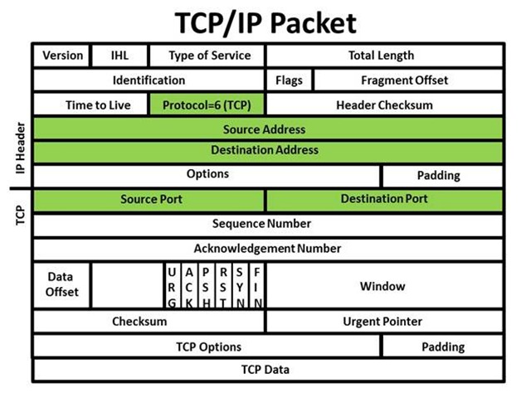
TCP
TCP Destination Port is in byte 23 (assuming no options)

Slide 9
IP Fragmentation and Reassembly
length
=4000
ID
=x
fragflag
=0
offset
=0
Original IP Packet
Example
4000 byte datagram
MTU = 1500 bytes
IP Header = 20 bytes
One large datagram becomes
several smaller datagrams
length
=1500
ID
=x
fragflag
=1
offset
=0
1480 bytes in data field
length
=1500
ID
=x
fragflag
=1
offset
=23
offset = 23
Overwrites TCP destination port changing port 80 to port 23
length
=1040
ID
=x
fragflag
=0
offset
=208

